Slide 1

Data Quality and Data Cleaning: An Overview

Slide 2
Outline
An Overview
Central Issues Of Data Quality
- Data Consistency
- Data Deduplication
- Data Accuracy
- Information Completeness
- Data Currency

Slide 3
An overview

Slide 4
An Overview
Traditional database systems typically focus on the quantity of data, to support the creation, maintenance and use of large volumes of data. But such a database system may not find correct answers to our queries if the data in the database are “dirty”, i.e., when the data do not properly represent the real world entities to which they refer.

Slide 5
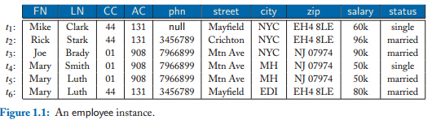
An Example
Let us consider an employee relation residing in a database of a company, specified by the following schema: employee(FN, LN, CC, AC, phn, street, city, zip, salary, status)
Here each tuple specifies an employee’s name (first name FN and last name LN),office phone (country code CC, area code AC, phone phn), office address (street, city, zip code), salary, and marital status.

Slide 6
Query Q1 is to find the number of distinct employees with FN = Mary
Due to D0, the answer maybe 3, by enumerating t4, t5, and t6
In fact, the correct answer to Q1 is 1.

Slide 7
Query Q2 is to find Mary’s current salary and current last name, provided that we know that t4, t5, and t6 refer to the same person.
Salary is either 50k or 80k, and that LN is either Smith or Luth.
We need reliable timestamps for the t4, t5, and t6.

Slide 8
Data in the real world is dirty
incomplete: lacking attribute values, lacking certain attributes of interest, or containing only aggregate data
e.g., occupation=“”
inaccurate: containing errors or outliers (spelling, phonetic and typing errors, word transpositions, multiple values in a single free-form field)
e.g., Salary=“-10”
inconsistent: containing discrepancies in codes or names (synonyms and nicknames, prefix and suffix variations, abbreviations, truncation and initials)
e.g., Age=“42” Birthday=“03/07/1997”
e.g., Was rating “1,2,3”, now rating “A, B, C”
e.g., discrepancy between duplicate records

Slide 9
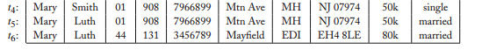
duplicated: there are more than one records those refer to the same entity.
Out of date: some records have been updated, and we do not delete the previous ones.

Slide 10
Why is Data Quality Important?
No quality data, no quality decisions!
Quality decisions must be based on good quality data (e.g., duplicate or missing data may cause incorrect or even misleading statistics)
Dirty data costs a lot.
It is reported that dirty data cost U.S. businesses 600 billion dollars annually, and that erroneously priced data in retail databases alone cost U.S. consumers $2.5 billion each year.
Data quality management is important!
These highlight the need for data quality management, to improve the quality of the data in our databases such that the data consistently, accurately, completely, timely, and uniquely represent the real-world entities to which they refer.

Slide 11
DATA CONSISTENCY

Slide 12
Data Consistency
Data consistency refers to the validity and integrity of data representing real-world entities. It aims to detect inconsistencies or conflicts in the data.
Inconsistencies in the data are typically identified as violations of data dependencies (a.k.a. integrity constraints)

Slide 13
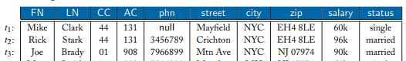
Consider tuples t1, t2, and t3 in Figure 1.1. There are discrepancies and conflicts within each of these tuples, as well as inconsistencies between different tuples.
It is known that in the UK (when CC = 44), if the area code is 131, then the city should be Edinburgh (EDI). In tuple t1 , however, CC = 44 and AC = 131, but city = NYC. That is, there exist inconsistencies between the values of the CC, AC, and city attributes of t1 ; similarly for tuple t2. These tell us that tuples t1 and t2 are erroneous.

Slide 14
Similarly, in the U.S. (CC = 01), if the area code is 908, the city should be Murray Hill (MH). Nevertheless, CC = 01 and AC = 908 in tuple t3, whereas its city is not MH. This indicates that tuple t3 is not quite correct.
It is also known that in the UK, zip code uniquely determines street. That is, for any two tuples that refer to employees in the UK, if they share the same zip code, then they should have the same value in their street attributes. However, while t1[CC] = t2[CC] = 44 and t1[zip] = t2[zip], t1[street] not equal to t2[street]. Hence, there are conflicts between t1 and t2

Slide 15
Errors in a single relation can be detected by intrarelation constraints such as extensions of functional dependencies, while errors across different relations can be identified by interrelation constraints such as extensions of inclusion dependencies.

Slide 16
Data deduplication

Slide 17
Data Deduplication
Data Duplication means there are more than one tuple refer to the same real world entity.
Data Deduplication aims to identify tuples in one or more relations that refer to the same real-world entity. It is also known as entity resolution, duplicate detection, record matching, record linkage, merge-purge, and object identification (for data with complex structures).

Slide 18
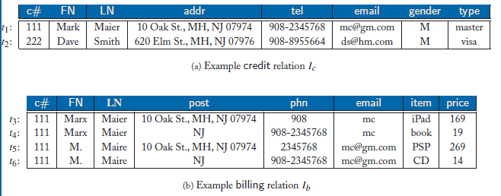
Consider two data sources specified by the following relation schemas:
credit(c#, FN, LN, addr, tel, email, gender, type),
billing(c#, FN, LN, post, phn, email, item, price).
For credit card fraud detection, check whether for all tuples t ∈ Ic and t∈ Ib:
if t [c#] = t[c#] then t [Yc] and t[Yb] refer to the same person, Yc = [FN, LN, addr, tel], Yb = [FN, LN, post, phn].

Slide 19
Challenges
The same object may be represented differently in different data sources.
t1[YR1]and t2[YR2] have the same type and refer to the same entity, however, t1[YR1] ≠ t2[YR2]due to errors in the data.

Slide 20
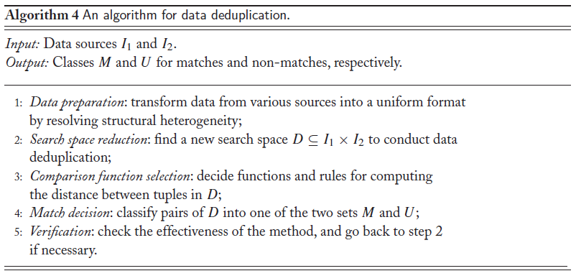
Algorithm
• (t1, t2) ∈ M if the pair is a match, i.e., t1[Y1] and t2[Y2] represent the same entity, and
• (t1, t2) ∈ U if the pair is a non-match, i.e., t1[Y1] and t2[Y2] refer to different entities.

Slide 21
Data Accuracy

Slide 22
Data Accuracy
Data accuracy refers to the closeness of values in a database to the true values of the entities that the data in the database represent

Slide 23
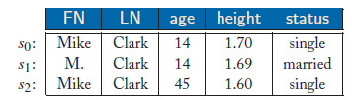
Consider a person schema person(FN, LN, age, height, status)
where a tuple specifies the name (FN, LN), age, height, and marital status of a person.
A person instance is shown Figure, in which s0 presents the “true” information for Mike.
From these we can conclude that s1[age, height] are more accurate than s2[age, height] as they are closer to the true values of Mike, while s2[FN, status] are more accurate than s1[FN, status].

Slide 24
It is more challenging, however, to determine the relative accuracy of s1 and s2 when the reference s0 is unknown, as commonly found in practice.
In this setting, it is still possible to find that for certain attributes, the values in one tuple are more accurate than the other by an analysis of the semantics of the data, as follows.

Slide 25
Suppose that we know that Mike is still going to middle school. From this, we can conclude that s1[age] is more accurate than s2[age]. That is, s1[age] is closer to Mike’s true age value than s2[age], although Mike’s true age may not be known. Indeed, it is unlikely that students in a middle school are 45 years old. Moreover, from the age value (s1[age]), we may deduce that s2[status] may be more accurate than s1[status].

Slide 26
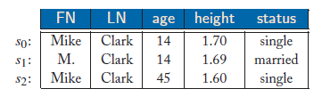
(2) If we know that s1[height] and s2[height] were once correct, then we may conclude that s1[height] is more accurate than s2[height], since the height of a person is typically monotonically increasing, at least when the person is young.

Slide 27
Data completeness

Slide 28
Data Completeness
Data Completeness concerns whether our database has complete information to answer our queries.
For a database D, query Q, we want to know whether Q can be completely answered by using only the data in D. If the information in D is incomplete, one can hardly expect its answer to Q to be accurate or even correct.

Slide 29
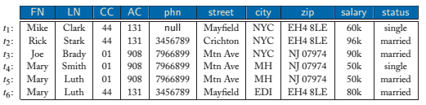

For query $Q_{1}$(to find the number of employees working in the NYC office (New York City)). Then the answer to $Q_{1}$ in $D_{0}$ is 3, by counting tuples $t_{1},t_{2}$ ${and t}_{3}$. However, if some tuples representing employees in the NYC office are missing from $D_{0}$, then the answer to $Q_{1}$ in $D_{0}$may not be correct.

Slide 30
Effects
Incomplete info effects for enterprises
Lead to misleading analytical results
Account for loss of revenues
Reduce credibility of customers for enterprises

Slide 31
Solutions
CWA(Closed World Assumption) It assumes that a DB has collected all the tuples representing real-world entities , but the values of some attributes in those tuples are possibly missing.
OWA(Open World Assumption) It assumes that in addition to missing values, some tuples representing real-world entities may also be missing. That is, our database may only be a proper subset of the set of tuples that represent those real-world entities.

Slide 32
Data currency

Slide 33
DATA CURRENCY
Data currency is also known as timeliness.
It aims to identify the current values of entities represented by tuples in a database, and to answer queries with the current values.

Slide 34
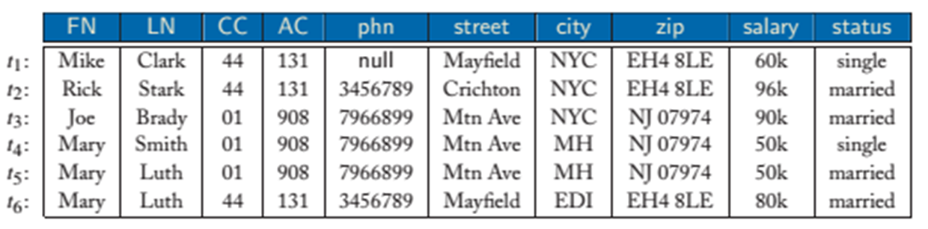
Query Q is to find Mary’s current salary and current last name
Mary’s salary is either 50k or 80k
LN is either Smith or Luth.
However, we can not tell whether Mary’s current salary is 50k, and whether her current last name is Smith or Luth.

Slide 35
Provided that we know that 𝑡_4, 𝑡_5, 𝑡_6 refer to the same person.
We may know that the salary of each employee in the company does not decrease, as commonly found in the real world. This tells us that 𝑡_6[salary] is more current than 𝑡_4[salary] and 𝑡_5[salary]. Hence, we may conclude that Mary’s current salary is 80k.
We know that the marital status can only change from single to married and from married to divorced, but not from married to single. In addition, employee tuples with the most current marital status also contain the most current last name. Therefore, 𝑡_6[LN]= 𝑡_5[LN] is more current than 𝑡_4[LN].That is, Mary’s current last name is Luth.

Slide 36
Solutions
In Theory
Insert valid timestamps into all data values
In Practice
Timestamps are often unavailable or imprecise. Data values are often imported from different sources. The scheme of timestamps is not uniform. Hard to identify the “latest” values of entities
Possible to deduce currency orders from the semantics of the data

Slide 37
Thank You！

